Slide 1
Applied Machine Learning for Text Analysis
(24ALT3101)
Large Language Model-Based Clinical Decision Support System
Submitted by:
K.Navya-240030180
N Deepika – 2420030097
K.Bhavya-2420030181
Group Number: 1 Section: 7
Under the Guidance of:
Mrs.Swanthana

Slide 2
Contents
Abstract
Problem Statement
Objectives
Literature Survey
Research Gap Identification
Innovation
Creativity
Novelty
Feasibility
Flowchart
Project Plan

Slide 3
Abstract
Clinical decision-making often requires healthcare professionals to interpret large amounts of patient information, clinical guidelines, laboratory results, and medical literature.
This project proposes a Large Language Model-Based Clinical Decision Support System (LLM-CDSS) that assists clinicians by summarizing patient information, identifying relevant clinical factors, and generating evidence-aware decision support suggestions.
The system combines an LLM with a clinical knowledge base and retrieval mechanism to provide contextual recommendations, explanations, and supporting evidence while keeping the clinician in the decision loop.
The proposed platform is designed to improve information accessibility, consistency, and decision support without replacing professional clinical judgment.

Slide 4
Problem Statement
Healthcare professionals must review diverse and continuously changing clinical information before making decisions. Manual review of patient histories, test results, guidelines, and medical literature can be time-consuming and may increase the risk of missing relevant information.
Traditional clinical decision support tools are often rule-based and may struggle with unstructured clinical text or complex patient contexts. General-purpose AI systems can also produce unsupported or misleading medical statements when they are not grounded in trusted clinical knowledge.
The proposed system addresses this challenge by using a Large Language Model with clinical knowledge retrieval and structured reasoning support to deliver relevant, explainable, and clinician-reviewed decision support.

Slide 5
Objectives
The main objectives of this project are:
• To develop an LLM-based Clinical Decision Support System for healthcare professionals.
• To process patient information and clinical notes using natural language understanding.
• To retrieve relevant clinical guidelines, evidence, and knowledge before generating suggestions.
• To generate concise, context-aware summaries and decision support recommendations.
• To provide explanations and supporting evidence for model-generated suggestions.
• To identify potential risks, missing information, and clinically relevant warning signals.
• To maintain a clinician-in-the-loop workflow so that final decisions remain with qualified professionals.
• To design a simple, responsive, and user-friendly clinical interface.

Slide 6
Literature Survey
Research Paper | Techniques Used | Purpose | Limitation
ClinicalBERT: Modeling Clinical Notes and Predicting Hospital Readmission (2019) | BERT, Clinical NLP | Learns representations from clinical notes for downstream healthcare tasks. | Focused on specific prediction tasks rather than interactive decision support.
GatorTron: A Large Clinical Language Model (2022) | Large Transformer, Clinical Text | Learns clinical language representations from large-scale healthcare text. | Large training and deployment requirements.
Large Language Models Encode Clinical Knowledge (2023) | LLMs, Medical QA | Investigates how language models can capture medical and clinical knowledge. | General knowledge does not guarantee patient-specific or evidence-grounded decisions.
Towards Generalist Biomedical AI (2023) | Multimodal / Foundation Models | Explores general-purpose AI for biomedical and clinical applications. | Complexity and safety considerations limit direct clinical deployment.
LLM-Based Clinical Decision Support (Recent Research) | LLM, RAG, Clinical Knowledge | Uses language models with retrieval and structured context for clinical assistance. | Requires reliable evidence retrieval, validation, privacy, and clinician oversight.

Slide 7
Research Gap Identification
• Many clinical AI models focus on a single prediction or classification task.
• General-purpose LLMs may generate plausible but unsupported clinical statements.
• Patient-specific context is not always combined with current clinical evidence.
• Several systems provide limited explanations for their recommendations.
• Privacy, safety, uncertainty, and clinician oversight are essential for practical adoption.
.
Innovation
The proposed system introduces:
• LLM-based clinical reasoning support over structured and unstructured patient information.
• Retrieval-Augmented Generation (RAG) to ground responses in trusted clinical knowledge.
• Evidence-linked recommendations with transparent supporting context.
• Risk and uncertainty indicators to highlight cases requiring closer review.
• Clinician-in-the-loop approval before any recommendation is acted upon.
• A practical web-based interface for summaries, alerts, and decision support.

Slide 8
Creativity
The project combines modern generative AI with a practical clinical workflow.
Key creative features include:
• AI-assisted patient case summarization.
• Natural-language interaction for clinical queries.
• Evidence retrieval alongside every major recommendation.
• Explainable suggestions showing relevant clinical factors.
• Risk flags for potentially critical findings.
• Suggested follow-up questions and missing-data prompts.
• Clinician review and feedback before final action.
• Clean dashboard for patient context, recommendations, and evidence.

Slide 9
Novelty
The uniqueness of this project lies in integrating:
• Large Language Models for natural-language clinical decision support.
• Retrieval-Augmented Generation for evidence-grounded responses.
• Patient-context understanding across clinical notes and structured data.
• Explainable recommendations with supporting evidence.
• Risk-aware outputs that communicate uncertainty and possible warning signals.
• A clinician-in-the-loop workflow rather than autonomous medical decision-making.
• A complete web-based clinical assistant instead of a standalone research model.
This combination aims to improve accessibility, transparency, consistency, and safety of AI-assisted clinical decision support.

Slide 10
Feasibility
The project is feasible because:
Technical Feasibility
Uses established technologies such as Python, web frameworks, LLM APIs/open models, vector databases, NLP libraries, and standard database systems. The architecture can be implemented as modular services.
Economic Feasibility
A prototype can be developed using open-source libraries and free or low-cost development resources. Cloud usage can be limited during experimentation.
Operational Feasibility
The system can be accessed through a simple clinical dashboard and designed around existing information review workflows.
Safety & Compliance Feasibility
The prototype can use de-identified or synthetic data, provide evidence and uncertainty indicators, and require clinician review before recommendations are acted upon.

Slide 11
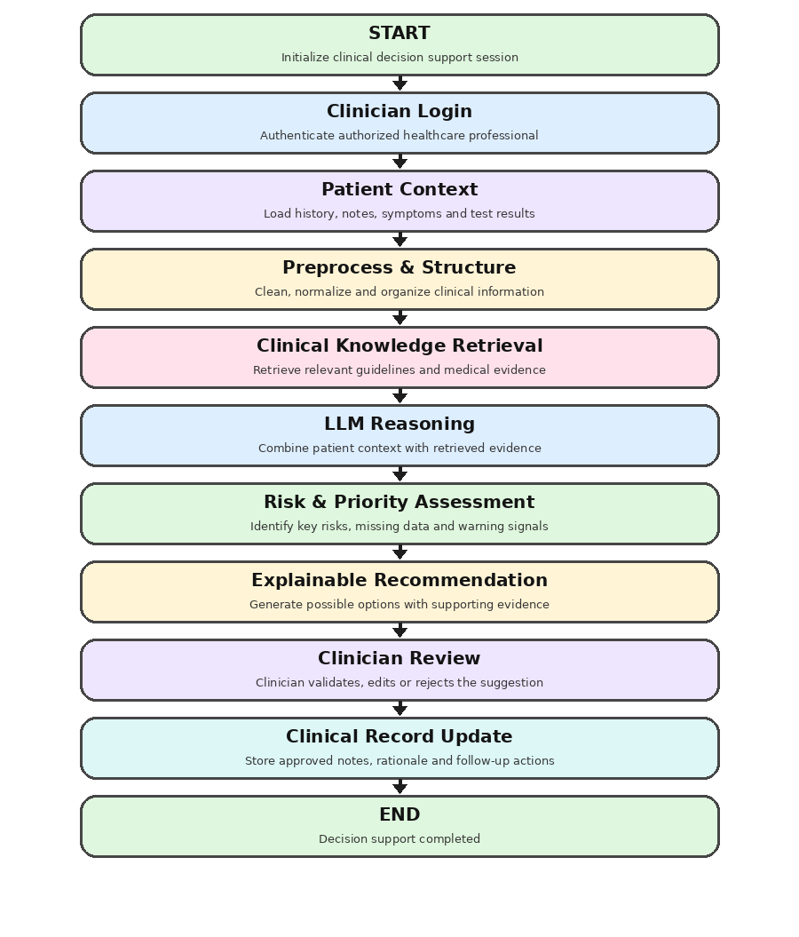
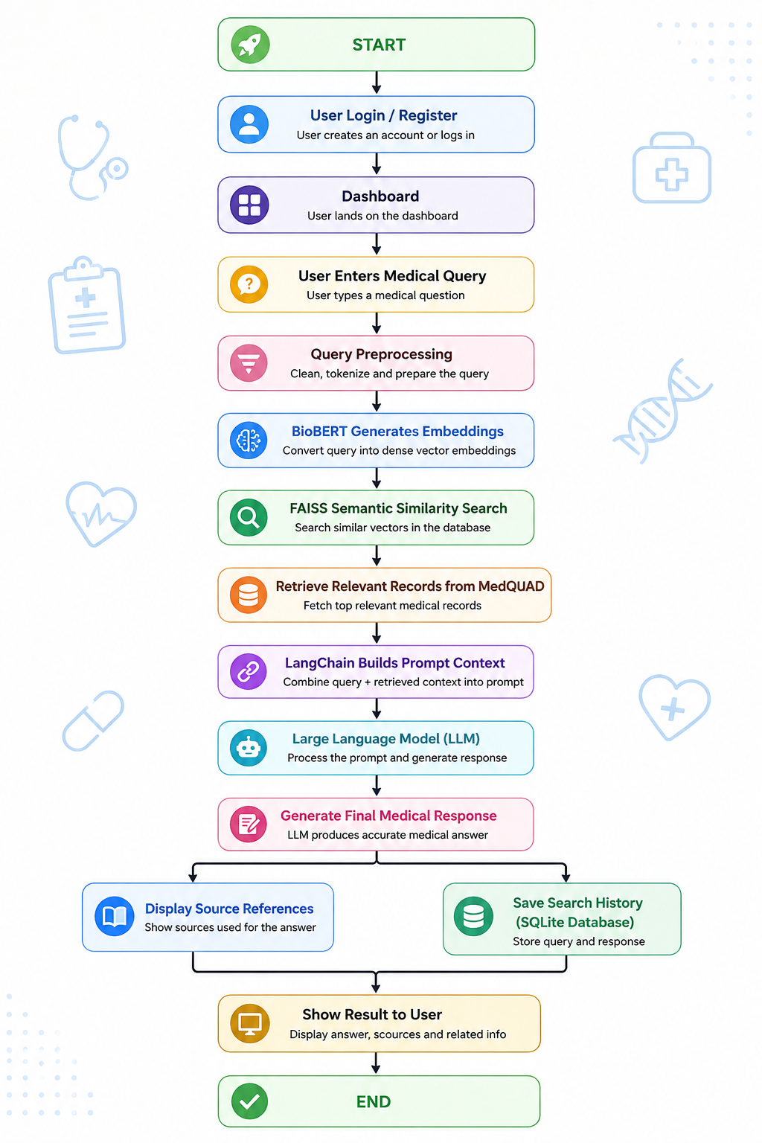
flowchart
Flow Chart

Slide 12
Project plan
 | Activity | Description
Phase 1 | Requirement Analysis | Define clinical workflow, objectives, scope, users, and safety requirements.
Phase 2 | Literature Survey | Study LLMs, clinical NLP, RAG, and existing clinical decision support systems.
Phase 3 | Data Preparation | Prepare de-identified or synthetic patient cases and trusted clinical knowledge sources.
Phase 4 | Clinical Text Processing | Clean, structure, and normalize patient notes and relevant clinical information.
Phase 5 | Knowledge Retrieval | Create embeddings and a vector index for retrieving relevant clinical evidence.
Phase 6 | LLM Integration | Connect the language model with patient context, retrieved evidence, and safety prompts.
Phase 7 | CDSS Workflow | Implement risk flags, summaries, recommendations, explanations, and clinician review.
Phase 8 | Frontend Development | Design a responsive dashboard for patient context, evidence, and decision support.
Phase 9 | Backend Development | Develop APIs, authentication, database connectivity, and model/retrieval services.
Phase 10 | Integration & Testing | Integrate all components and test accuracy, usability, robustness, and safety.
Phase 11 | Documentation & Deployment | Prepare report, presentation, user documentation, and deploy the prototype.

Slide 13
Thank you

